Slide 1
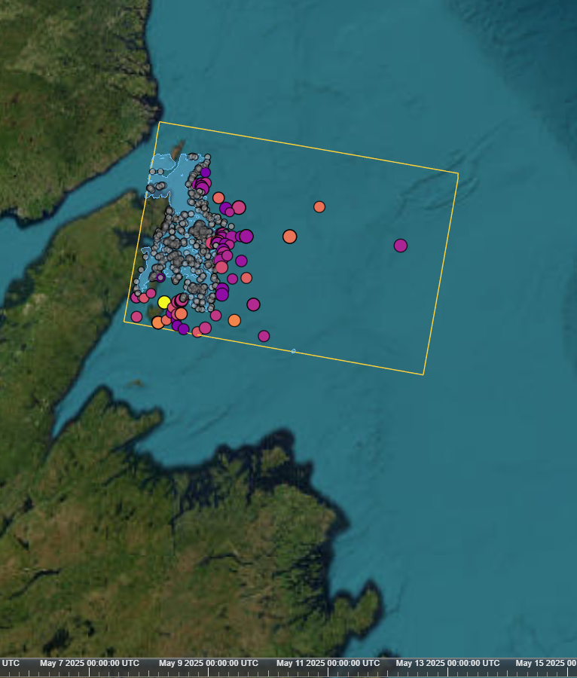
Iceberg Alley SAR
PROJECT BRIEF · SENTINEL-1 SAR
Detecting icebergs off Newfoundland in satellite radar, and showing them on an interactive globe with a timeline.
Natali Kovalski · October 2026
Notes:
A portfolio project: hands-on SAR and maritime-domain work, from raw Sentinel-1 scenes to a validated detector and a CesiumJS viewer. Fifteen years of photogrammetry and geospatial AI, applied to a new sensor.

Slide 2
Every spring, icebergs drift into busy water
THE PROBLEM
01
02
03
The hazard
The gap
The idea
Greenland bergs ride the Labrador Current down "Iceberg Alley", past shipping lanes, fishing grounds and offshore platforms.
Aircraft reconnaissance is costly and limited by weather, and this coast is often fogged in.
Satellite radar sees through cloud and darkness. Sentinel-1 data is free and revisits every few days.
Iceberg Alley SAR · Project brief
2
Notes:
Area of interest: the northeast Newfoundland coast, roughly Bonavista to St. Anthony, extending offshore. April to June has the most icebergs.

Slide 3
Six steps from raw scene to globe
APPROACH
01
02
03
04
05
06
Search
Calibrate
Mask
Detect
Filter
Publish
ASF search for HH+HV scenes over the AOI
HyP3 terrain correction: gamma0, linear power, 10 m
Land plus 500 m from OSM; pack ice from HV texture
CA-CFAR on HV, threshold set from the scene's speckle
Size limits, ice-strip rejection, HH co-pol check
GeoJSON with attributes, then CZML for the Cesium viewer
Every parameter lives in config.yaml, with lengths in metres so tuning carries over between 10 m and 20 m pixels.
Iceberg Alley SAR · Project brief
3
Notes:
Steps 4 and 5 (orange) are the detector itself. Each detection keeps its incidence angle, contrast, size and distance to pack ice as attributes.

Slide 4
Four ideas behind the detector
SAR IN ONE SLIDE
Backscatter
Polarization
Calm water reflects radar away and looks dark. An iceberg's facets send energy back and look bright.
Sea clutter is far weaker in cross-pol (HV), so bergs stand out there. HH is the second check.
Speckle
CFAR
Grainy noise in every SAR image. Its strength (ENL) is measured per scene and sets the threshold.
Each pixel is compared with its local background, so false alarms stay rare in calm and rough seas.
Iceberg Alley SAR · Project brief
4
Notes:
A subtlety worth mentioning: HyP3 removes the HV thermal noise floor, so open-water HV sits at -30 to -40 dB with ENL below 1. A textbook ENL would set the threshold far too low, so ENL is estimated from each scene. Detection runs on linear power; dB is for display and reported values.

Slide 5
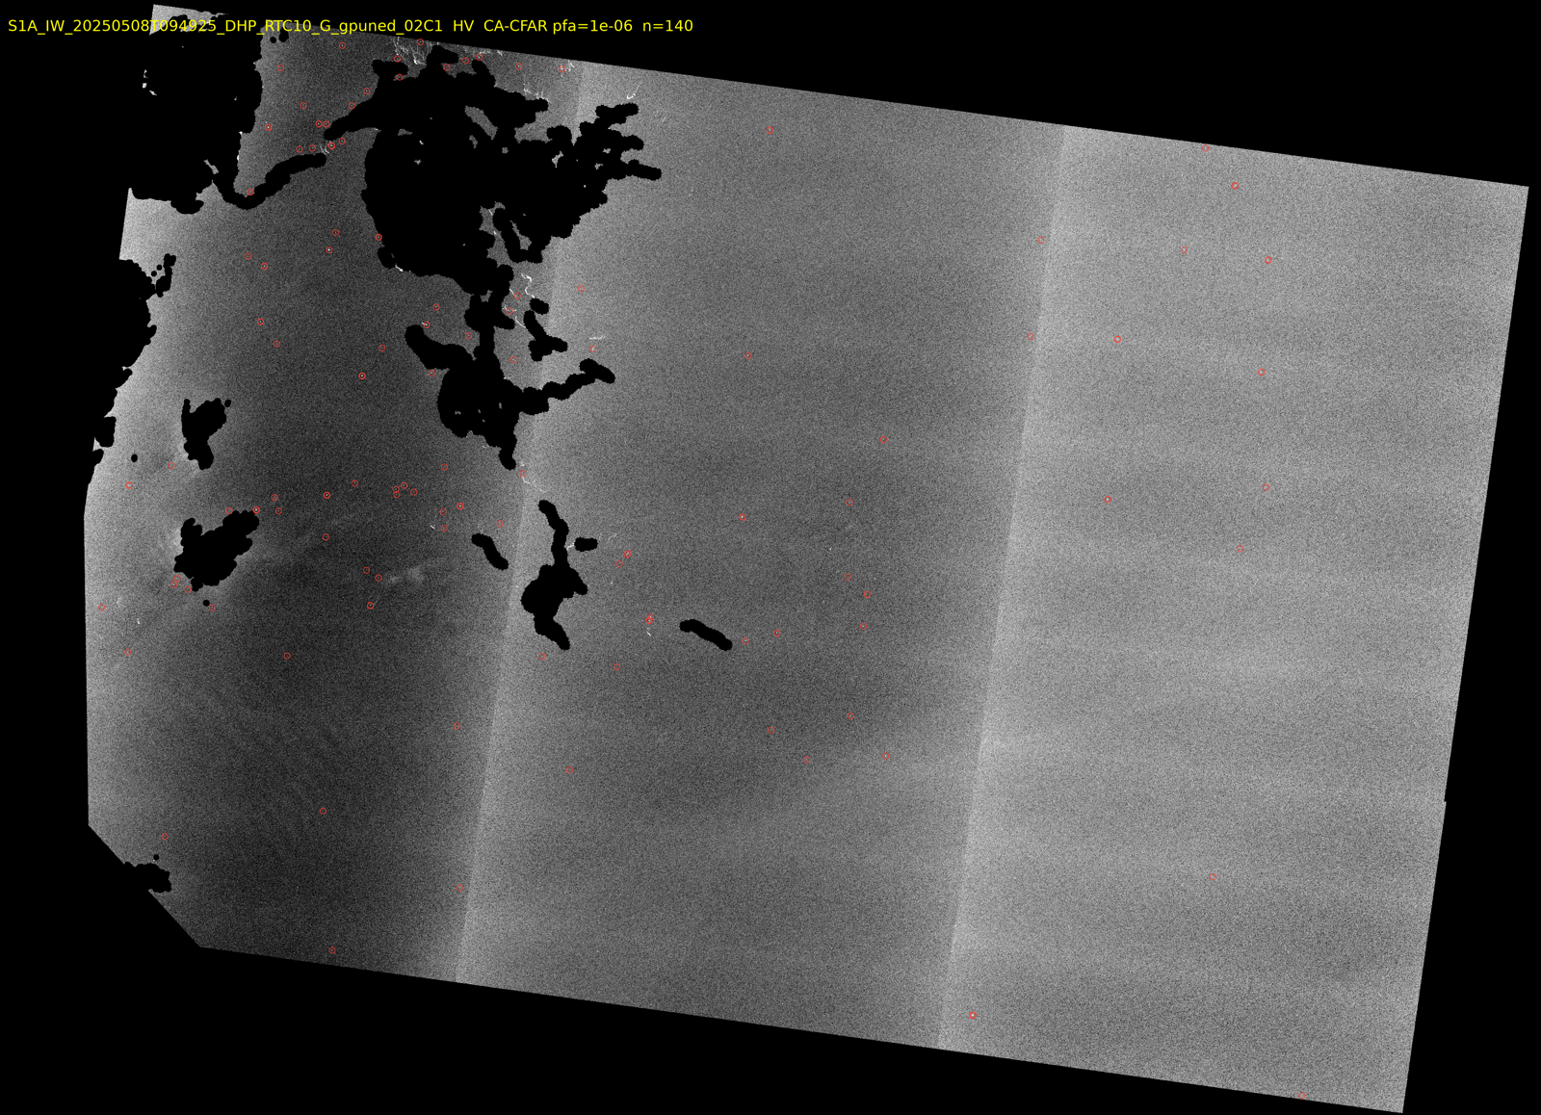
CFAR on HV, then three filters
DETECTION
Threshold from a 10⁻⁶ false-alarm rate, speckle measured per scene
Size: 2 px to 0.8 km²
Ice strips: reject bright structures longer than 300 m
HH check: at least 6 dB above background in both polarizations
HV, 2025-05-08. Land and pack ice masked (black), 140 detections circled.
Iceberg Alley SAR · Project brief
5
Notes:
The HH check matters at 10 m: IW GRD is oversampled (true resolution about 20 m), so HV speckle grains span about 2x2 pixels and pass the size filter. Real targets are bright in both polarizations. Thin strips of loose sea ice were the main false-alarm source until the structure-length filter. The vertical brightness steps in the image are the three IW sub-swaths.

Slide 6
Every candidate on a globe, by date
VIEWER
Scrub the timeline through the spring 2025 passes
Click a target to see its attributes
Colour shows contrast, size shows extent
Grey: within 5 km of pack ice, likely floes
Iceberg Alley SAR · Project brief
6
Notes:
Vue 3, Vite and CesiumJS, fed by a time-dynamic CZML file with one interval per scene. Esri imagery basemap, so no Cesium ion token is needed. Nothing is deleted: near-ice candidates are greyed out and can be hidden with a checkbox.

Slide 7
HEADLINE RESULT
78%
of the icebergs that International Ice Patrol analysts marked on the same Sentinel-1 pass were found: 209 of 268.
2019-04-29 · median position difference 128 m · recall steady at 73–84% from the coast to 100 km offshore
Iceberg Alley SAR · Project brief
7
Notes:
Validation uses spring 2019 because the IIP sightings database (NSIDC G00807) ends with the 2021 season. Same pipeline, same parameters as the 2025 scenes. Matching is one-to-one within 500 m. Caveat: the analysts looked at the same radar image, so this measures agreement with expert interpretation, not independent truth.

Slide 8
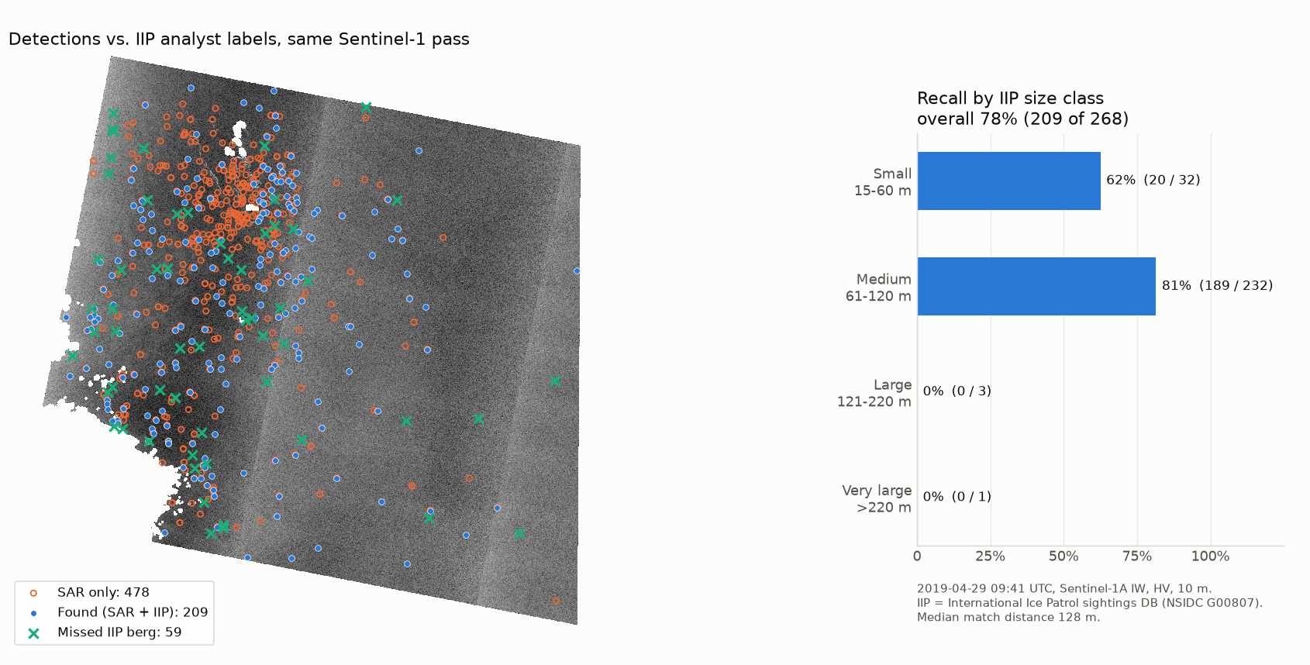
Medium bergs are found best
RECALL BY SIZE
Berg size | Recall
Small, 15–60 m | 62%
Medium, 61–120 m | 81%
Large, over 120 m | 0 of 4
All | 78%
Detections vs. IIP analyst labels, 2019-04-29.
Iceberg Alley SAR · Project brief
8
Notes:
The four large bergs each have a detection 1 to 4 km away but none on the berg. Likely causes: the 300 m ice-strip filter, and a CFAR guard window smaller than the berg, which leaks part of the berg into its own background estimate. Small bergs that are a single 10 m pixel in HV are removed by the 2-pixel minimum.

Slide 9
Every ground-truth source has a catch
VALIDATION
Source | What it gives | Outcome
NAIS iceberg chart | Counts per 1° square | Within 2–4×, but opposite errors cancel
IIP aircraft sightings | Positions 5–7 h after the pass | Inconclusive: drift unresolved
Sentinel-2 optical | Bright objects at 10 m | Loose sea ice in April, bergs inshore in June
IIP labels, same pass | Positions on the same image | Headline: 78% recall, no drift
Where truth comes hours later, the code estimates a common drift offset and checks it against chance. If the peak is weak, it reports "drift unresolved" instead of a score.
Iceberg Alley SAR · Project brief
9
Notes:
NAIS charts are partly modelled and include growlers too small for SAR. Inshore, SAR finds 3 to 8 times the chart count; offshore on rough days it finds fewer. Sentinel-2 in April showed up to 37,800 bright objects per tile, mostly ice floes, so optical cannot separate small bergs from floes at 10 m.

Slide 10
What the numbers don't show yet
LIMITS AND NEXT STEPS
Limits
Next
Precision unknown: 475 of 684 detections are unlabelled bergs, boats or false alarms
Large bergs missed: 0 of 4 over 120 m
Rough seas raise the HV background 3–4 dB
Near pack ice, many targets are floes (flagged, not removed)
AIS ship positions for the same passes, to measure precision
Size-aware filters: scale the strip filter and guard window to the target
OS-CFAR or K-distribution for heavy-tailed sea clutter
Docker and a hosted static viewer
Iceberg Alley SAR · Project brief
10
Notes:
31% (209 of 684) is a lower bound on precision, not an estimate. The unlabelled detections are strong targets, similar in size to matched ones, and concentrated among labelled bergs. An experimental iceberg-vs-ship CNN trained on the Kaggle Statoil/C-CORE chips exists, but it is mostly unsure on our data and is used only as a review hint.

Slide 11
One command, end to end
BUILD
python -m iceberg_sar.cli run --start 2025-05-01 --end 2025-05-15
Processing
Data
Viewer
Quality
Python 3.11, numpy, scipy, rasterio, GeoPandas, typer CLI
asf_search, HyP3 RTC, OSM land polygons, IIP sightings
Vue 3, Vite, CesiumJS, time-dynamic CZML
67 pytest tests, all parameters in config.yaml
Re-runs reuse downloaded scenes and existing outputs. A dry run shows the plan and the HyP3 credit cost before anything is ordered.
Iceberg Alley SAR · Project brief
11
Notes:
The run searches ASF, keeps the best-covering HH+HV scenes, orders HyP3 RTC processing (60 credits per 10 m scene), then masks, detects and exports CZML. Masking plus detection takes about 17 minutes per 10 m scene on a laptop.

Slide 12
Questions?
THANK YOU
Natali Kovalski · github.com/natali-kovalski/Icebergs
Contains modified Copernicus Sentinel data (2019–2025). Iceberg data: International Ice Patrol (NSIDC G00807) and the North American Ice Service. Land polygons © OpenStreetMap contributors.
Notes:
The repository has the full write-up: method, validation findings and limitations, plus the viewer.

